Slide 1


Prep yourself for abroad
Project nr. EAC-2020-0866
This communication reflects the views only the author’s view, and the Commission cannot be held responsible for any use which may be made of the information contained therein

Slide 2
Get to know your destination
country
  language
    learn or improve the local language even a bit
    Mobility period can be an ideal option to develop and deepen the existing language skills.
  culture
  watch a movie (but don’t believe it completely)

Slide 3
Get to know your destination
city
  restaurants, sport activities, festivals, events, theatres, concerts
  museums, shopping malls, cafes’, outlets
  nearby touristic and cultural sights
  have fun
  check websites for tourist warnings (be ready, not scared)
  transportation

Slide 4
Get to know your destination
school, work place
  working hours
  Study fields, products…
study/work-life balance

Slide 5
Before the trip
health information
packing
travel light
check your flight info for baggage restrictions
get some local food or sweets (eat it when you miss home)
list the items that you can buy at the stores in your host country
Most valuable and personal items should be packed in your carry-on luggage to minimize loss if your baggage is misplaced (e.g., money and medicine).
Never carry items for strangers
consider the temperature changes of your host country

Slide 6
Skills to use
time management
- be on time
communication
- talk to get the most out of the exchange

Slide 7
First few weeks
New food, unfamiliar road signs, no decent coffee
Away from friends and family
Prep yourself: the fewer surprises, the more in control
Don’t expect to get everything right straight away. (Everyone gets lost)
Explore your new country
Make sure to be able to contact when you need.
Family
Teacher / international coordinator
Friends
Keep busy, meet people.

Slide 8
New Country
New Experiences, new competences
Personal Development
Career and Professional Growth
Travel and Adventure
New Circle of Friends
Self confidence

Slide 9

Culture Shock

Slide 10
Introduction
What is Culture shock?
Why is it a problem for educators?
What are some strategies for minimizing the effects of culture shock?
Notes:
ME

Slide 11
Culture Shock is:
Today we understand culture shock as a reaction people experience when faced with cultural realities that differ from their own personal expectations and norms.
Notes:
Oberg was a world traveling anthropologist and applied the term “culture shock” to all people that traveled to new cultures.

Slide 12
Oberg’s Stages
Honeymoon/Tourist Stage
1
Culture shock/
rejection
2
Recovery
3
Adjustment/
Acculturation
4
Notes:
Briefly describe each stage and demonstrate the U curve on the black board.
Me-Oberg’s 6 aspects of culture shock

Slide 13
Contributing factors
Unfamiliar rules for social interaction
Strange environment and climate
Low levels of similarities in beliefs, values, norms, and attitudes
Misinterpretations of behaviors and intentions of the other cultural group
Motivations for/ traumas associated with traveling to the new culture
Notes:
Ethnocentrism- Ideas of cultural superiority
Tendency to stereotype- Does the individual or their culture tend to be open minded to differences?
Low levels similarities in beliefs, values, norms, and attitudes- self explanatory
Misinterpretations of behaviors and intentions- Cultural differences in norms of social interaction, non verbal communication, etc.
Motivations for traveling/traumas associated with to the new culture- Voluntary immigrant? Involuntary refugee?

Slide 14
Causes:
Unfamiliarity with the new culture and surroundings
Inability to effectively use or understand new language and cultural symbols
Discrepancies between the demands of new situations and the resources for dealing with them
Cognitive fatigue
Notes:
ME

Slide 15
Culture Shock is Manifested:
Mentally
Emotionally
Physically

Slide 16
Symptoms
Difficulty in focusing and processing/retaining new information
Small aches, pains, and new allergies
Sleeping too much or too little
Feeling sad, depressed, vulnerable, powerless
Decreased confidence, increased apathy
Developing stereotypes of the dominant culture

Slide 17
Potential Problems for Educators
  High Anxiety
  Low Motivation
  Low Self-confidence
Misinterpretation of culture shock side effects as products of learning disabilities
Physical effects that result in frequent absences
Notes:
ME Krashen’s affective filter Hypothesis (pg137 Collier) “ A low affective filter exists when the student feels comfortable and non-threatened in the learning environment. A high affective filter exists when a person is too pressured by outside factors to relax and allow the acquisition process to occur.” The level of three factors effect a person’s affective filter.
Pg. 125

Slide 18
Possible other challenges and problems
Housing problems
Economic problems
Nutrition problems
Health problems
Transportation
Notes:
Lack of confidence, feelings of isolation, and emotional strain of culture shock can cause problems in other areas of their lives. The processes of finding quality housing, a job, and figuring out the new transportation systems and shopping rituals as well as utilizing the available social services may become daunting and seemingly impossible resulting in further with drawl. Eating habits and over all health can be effected.

Slide 19

How to Combat Culture Shock
Create
Create a comfortable and accepting environment as individual.
Keep
Keep busy, be active
Count
Count your blessings, stay confident
Be
Be patient, be constructive
Don’t try
Don’t try too hard
Open
Open yourself to new possibilities
Keep in
Keep in touch with home
Seek
Seek support and advice
Notes:
ME Make these children feel accepted, if school is the only place where they feel culture shock they won’t want to go.
Don’t automatically assume it is a learning disability.
Talk with the parents, get an interpreter if you have to.
Don’t give up on a student, too often students who are highly capable get lost and drop out only to take a low paying job or join a gang.

Slide 20
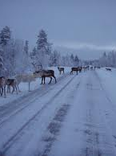
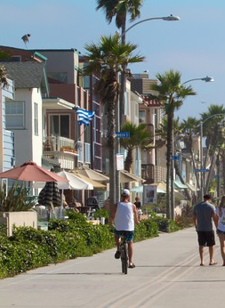
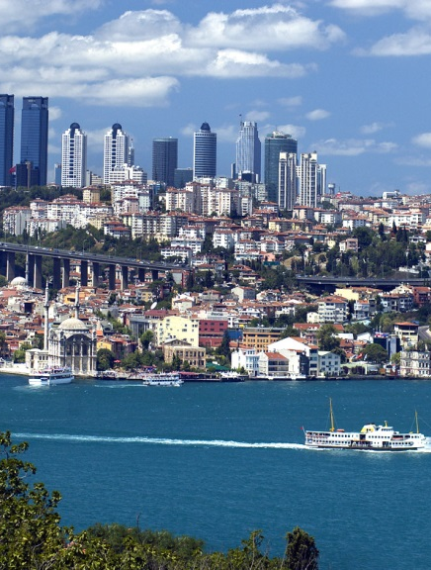

Culture Shock: case Finland
Notes:
Why am I telling them my story?

Slide 21
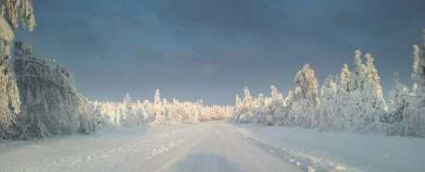
Coming to Finland
Cold Land, warm people
Language – strange and hard to learn for foreigners
Winter/Summer
  Bright nights (summer)/dark days (winter)
Notes:
Drive on a lake, walk on sea, run from dogs on river, car out of road, teach finnish to foreigners for fun, pretty but cold, rainy london, mom and all day long day,

Slide 22
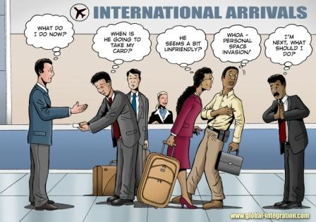
Cultural differences in greetings
  Hand shake – yes, before COVID
  Kissing - Not
  Nod – yes

Slide 23
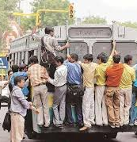

Finnish culture vs. other cultures
Silence in Finland
Possible differences in etiquette
Customer service (too straight?)
Food, Salmiakki, Coffee
Early warm lunch and warm dinner
Sauna, Ice swimming
Not so much traffic
Visit Finland - 10 Things That Will SHOCK You About Finland
Notes:
Silent or not? I can’t stand silence, normal people size, are the sellers too pushy. WHO SWIMS IN ICE?, testing foreigners

Slide 24
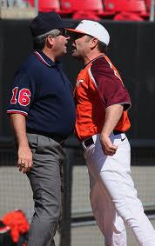
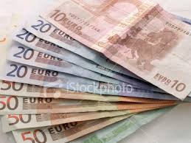
Living in Finland
Personal space – differences?
  Finns need their own personal space!
Services
  Too straight for foreigners
Accommodation
  Expensive
Work Culture
  Not so much small talk…
  Finns concetrates to the work
Payment
  Prices are shown
  no need for tips normally
Notes:
Personal space, you don’t get the same services, being foreigner as a big sign, relax and sleep, different cultures in the work place, how to pay cash or card?

Slide 25
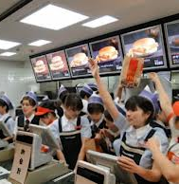
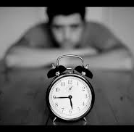
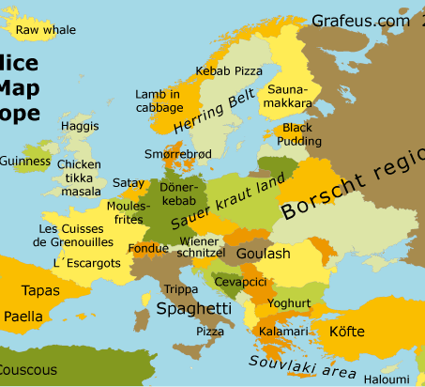
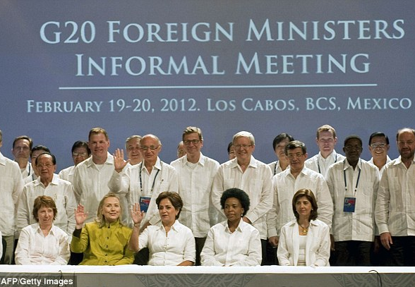
Differences?
Time – Almost always on time..
Food – different?
Talking with hands
Small talk – not so much…
Dress code – Casual?
Notes:
Late only couple of days, how late is late? Spicy food? Pizza all the time? Small talk exercise? Politics, money what not to talk? Dress like the natives

Slide 26

Reverse Culture shock
Home Sweet Home?
When you come back to your home you might feel another culture shock!
That’s normal!
Notes:
Boredom No one wants to listen You can’t explain Reverse homesickness Relationships have changed People see 'wrong' changes People misunderstand you Feelings of alienation Inability to apply new knowledge and skills

